Slide 1


Technology Networks for Conservation Agriculture: Kitale, Kenya
Jennifer Lamb
SANREM CRSP
Technology Networks Workshop
Kitale, Kenya
February 16, 2012
Notes:
Thank you for being here, I am excited to share with you the results of our study on networks for CA

Slide 2
What is the project?
Lead institution: University of Wyoming
Development and Transfer of Conservation Agriculture Production Systems (CAPS) for Small-holder Farms in Eastern Uganda and Western Kenya

Slide 3
Who are the implementing partners?
Universities:
University Of Wyoming
Makerere University
Moi University
Ngo’s:
AT Uganda
Manor House
Sacred Africa
Local Farmer Groups/Key Stakeholders

Slide 4
Core Principles of Conservation Agriculture
Three principles:
Crop rotation
Mixing and rotating crops which maintain/improve soil fertility
Maintaining a permanent crop cover
The soil should be covered as much as possible
Minimizing tillage
Disturb the soil as little as possible

Slide 5
Mix and rotate crops
Conventional farming:
Same crop is sometimes planted each season
Allows certain pests, diseases and weeds to survive and multiply, resulting in lower yields.
Conservation agriculture:
This is minimized by:
Planting the right mix of crops in the same field
Rotating crops from season to season that require different nutrients from the soil.
Helps to maintain soil fertility.

Slide 6
Maintaining crop cover
Conventional farming:
Remove or burn the crop residues or mix them into the soil with a plough or hoe
Soil is left bare, so it is easily washed away by rain, or is blown away by the wind.
Conservation agriculture:
Crop residues left on the field
Mulch and special cover crops protect the soil from erosion
Helps limit weed growth throughout the year.

Slide 7
Minimizing Tillage
Conventional farming:
farmers plough/hoe to improve the soil structure and control weeds.
Over the long term, this:
destroys the soil structure
contributes to declining soil fertility
Conservation agriculture:
Tillage is reduced to ripping planting lines or making holes for planting
Ideal: plant direct into the soil
Accomplished without plowing/disturbing the rest of the field

Slide 8
SANREM Principles and procedures
Working with partners in the targeted research communities
Understanding values of activities to community members
How community members benefit
Created local advisory councils—why you are here today

Slide 9
Principles and procedures
Research Project Objective:
Develop new knowledge to be applied by community members
Project does not have the resources to provide inputs, means for achieving development on a large scale
Learning partnerships:
Researchers committed to learning from community members
Production systems and way of life
Communities should benefit by
Learning about their resources, potentials
How to build more sustainable and profitable systems

Slide 10
Principles and procedures
Conducts research with individuals and communities is on a voluntary basis.
Successful learning occurs when individuals choose of their own accord to think and act in new ways.
Our job is to present and test new ideas and technologies with those communities and community members who are interested in actively learning about new ways to manage their resources.

Slide 11
What is conservation tillage?
Conservation tillage is any method of soil cultivation that leaves the previous year's crop residue (such as corn stalks or wheat stubble) on fields before and after planting the next crop, to reduce soil erosion and runoff.
To provide these conservation benefits, at least 30% of the soil surface must be covered with residue after planting the next crop. Some conservation tillage methods forego traditional tillage entirely and leave 70% residue or more.

Slide 12
Why practice conservation tillage on your land?
Environmental benefits
Reduces soil erosion by as much as 60%-90% depending on the conservation tillage method; pieces of crop residue shield soil particles from rain and wind until new plants produce a protective canopy over the soil
Improves soil and water quality by adding organic matter as crop residue decomposes; this creates an open soil structure that lets water in more easily, reducing runoff
Reduces potential air pollution from dust and diesel emissions
Crop residue provides food and cover for wildlife
Conserves water by reducing evaporation at the soil surface
Conserves energy due to fewer tractor trips across the field

Slide 13
Practical benefits
Fewer trips across the fields
saves time and money (lowers fuel, labor and machinery maintenance costs)
reduces soil compaction that can interfere with plant growth
Optimizes soil moisture, enhancing crop growth in dry periods or on droughty soils

Slide 14
Where we are in the process
This is a 4 year project. We have 3 years left.
Baseline data collection conducted year 1
Understand the local production system before the project
Includes trying to understand what people’s thinking about CA was before we started.
Today’s presentation is to show you some of the results of that baseline study.
We have also completed the first year of experimental trials to begin testing CA principles
Results are being analyzed.
Will also be shared with you soon.

Slide 15
Types of CA Tillage Methods
Conservation tillage is especially suitable for erosion-prone cropland. In some agricultural regions it has become more common than traditional moldboard plowing.
Conservation tillage methods include no-till, strip-till, ridge-till and mulch-till. Each method requires different types of specialized or modified equipment and adaptations in management.
No-till and strip-till involve planting crops directly into residue that either hasn't been tilled at all (no-till) or has been tilled only in narrow strips with the rest of the field left untilled (strip-till).

Slide 16
Additional Types of CA
Ridge-till involves planting row crops on permanent ridges about 4-6 inches high. The previous crop's residue is cleared off ridge-tops into adjacent furrows to make way for the new crop being planted on ridges. Maintaining the ridges is essential and requires modified or specialized equipment.
Mulch-till is any other reduced tillage system that leaves at least one third of the soil surface covered with crop residue.

Slide 17
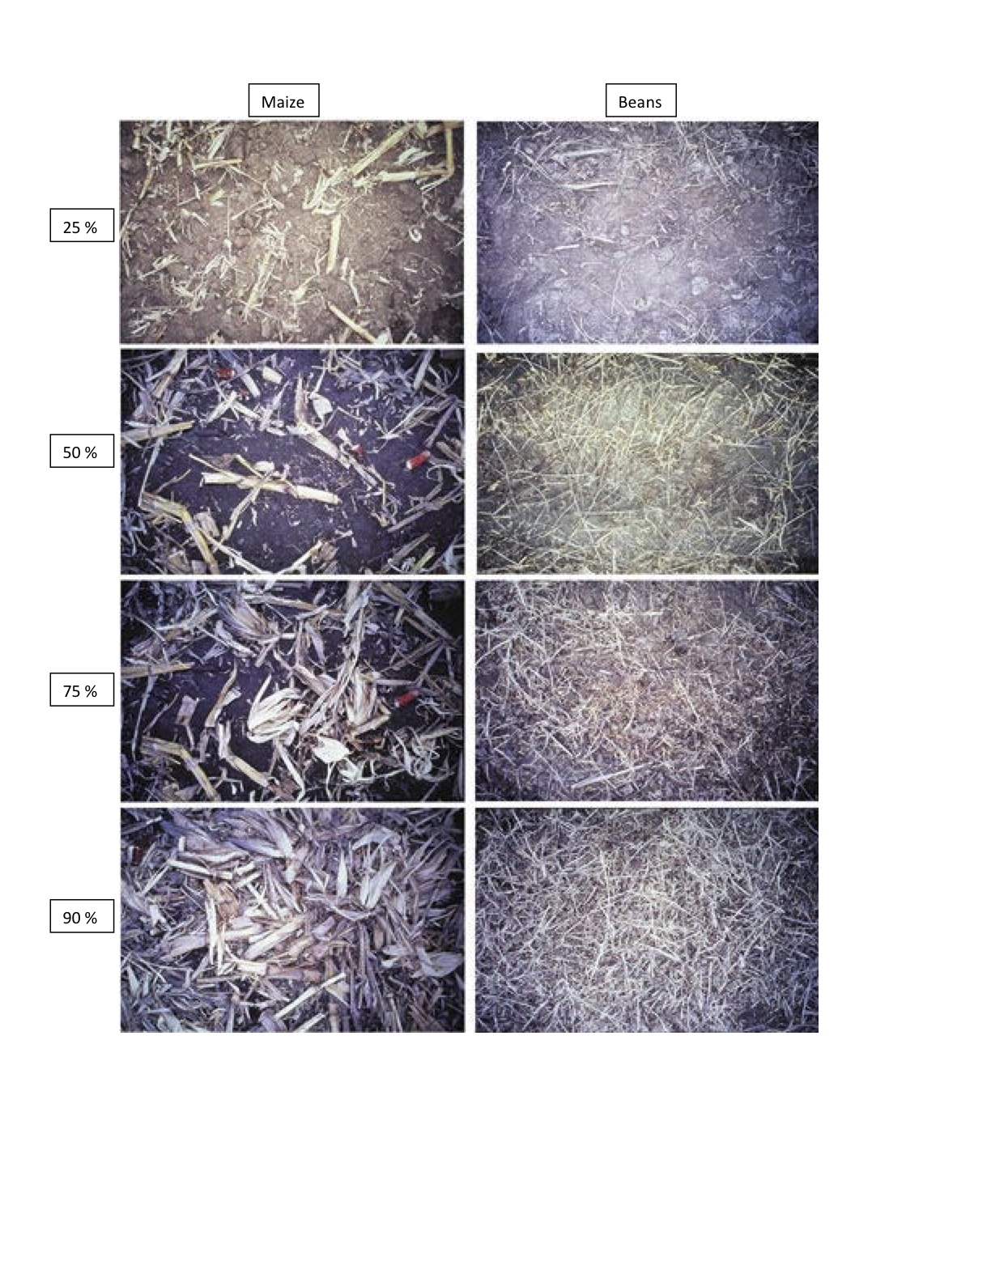

Slide 18
Bare soil = BAD

Slide 19
Researching Technology Networks for CA
Successful Conservation Agriculture
Broad based support network
Change in mindset regarding agricultural production practices
Everyone has to be involved
Why we have tried to bring you all here today
Notes:
Change in mindset? –CA means a considerable shift from the way things are currently done

Slide 20
Research Process
Focus Groups in 2010
Identify key contacts for agricultural production
List of 21 key actors
Survey conducted in 2010
79 farm households were asked about their key contacts for agricultural information/resources in Trans-Nzoia District
Kibomet and Milimani Sub-locations
Follow up interviews conducted with 21 individuals in 2011
Community agents
Agricultural service providers
Workshop today

Slide 21
Research Aims
Understand existing mindsets with regard to agricultural production…hekima kwa kilimo
Especially with regard to conservation agriculture
Map the structure of agricultural production networks (ya mtandao wa kulimo) in Tranz-Nzoia District
Prioritized Identifying:
Key contacts or nodes in the network
For farmers (kwa mkulima)
In the whole agricultural production network (kwa kila mtu katika matandao wa kulimo)
Knowledge and beliefs about CA
Differences between farmers and service providers/community agents

Slide 22
Farmer Involvement in Agricultural Networks
Variable | Observations | Mean | Standard Deviation | Min Value | Max Value
Resource Contacts | 79 | 5.72 | 2.54 | 0 | 11
Information Contacts | 79 | 7.50 | 4.59 | 0 | 18
Notes:
Mto kwa resources == mbolea, mbegu, pesticide/herbicide, kulima
Information kwa kulimo =

Slide 23
Key Resource Contacts for Farmers
Agent Type: | Number of Reports (Out of 79): | Percentage of Farmers Reporting Contact:
Vendor in a agro-vet shop | 68 | 86%
Veterinary Service provider | 68 | 86%
Government Parastatals | 55 | 70%
Tractor owner/ animal traction provider | 54 | 68%
Neighbor/friend | 45 | 57%
Agricultural researcher | 30 | 38%
Family Member | 26 | 33%
Agricultural/Micro Finance Representative | 22 | 28%
Government Extension agent | 19 | 24%
Vendor in a shop in urban center | 18 | 23%
Village/Subcounty chief | 11 | 14%
Vendor in weekly market | 11 | 14%
NGO/ Development Agent | 7 | 9%
Leader of farmer organizations | 6 | 8%
Leader of women’s organization | 5 | 6%
Teacher in village | 3 | 4%
Leader of youth organisation | 3 | 4%
Minister/Priest/Imam in village | 1 | 1%
Local Political leaders | 0 | 0%
Notes:
Describe top resource contacts

Slide 24
Key Information Contacts for Farmers
Agent Type: | Number of Reports (Out of 79): | Percentage of Farmers Reporting Contact:
Vendor in a agro-vet shop | 69 | 87%
Veterinary Service provider | 64 | 81%
Government Parastatals | 59 | 75%
Neighbor/friend | 54 | 68%
Government Extension agent | 41 | 52%
Family Member | 37 | 47%
Village/Subcounty chief | 36 | 46%
Agricultural researcher | 33 | 42%
Tractor owner/ animal traction provider | 31 | 39%
Agricultural/Micro Finance Representative | 22 | 28%
Leader of farmer organizations | 21 | 27%
Local Political leaders | 21 | 27%
Leader of women’s organization | 20 | 25%
Leader of youth organisation | 17 | 22%
Vendor in a shop in urban center | 16 | 20%
NGO/ Development Agent | 16 | 20%
Vendor in weekly market | 15 | 19%
Minister/Priest/Imam in village | 11 | 14%
Teacher in village | 10 | 13%
Notes:
-Importance of local actors advising on CA. Most frequently reported persons in the network are those who are close to where people live

Slide 25
Network Structure
Matched the farmer data (79) to Technology Networks Data (21)
Determine Influential Nodes:
Degree Centrality = Number of contacts for agricultural information
Betweenness Centrality = Score which indicates the extent to which an agent controls the transmission of information between contacts
Rank | Agent | Degree Centrality | Betweeness Centrality
1 | Ministry of Agriculture | 20 | 20.87
2 | Microfinance Institutions | 20 | 20.05
3 | Stakeholder Forum | 20 | 17.29
4 | NGO | 17 | 11.23
Notes:
Refer to the brochure to explain the network centralities.

Slide 26
Knowledge and Beliefs about Agricultural Production
Focus on the Three Principles of CA:
Crop rotation
Maintaining a permanent crop cover
Minimizing tillage
Corresponding statements on questionnaire:
“Rotating crops is always best practice”
“One should maintain a permanent crop cover”
“Tillage causes land degradation”
Farmers indicated agreement on a scale of 1-5
5 = “strongly agree”
1= “strongly disagree”

Slide 27
Disaggregating Knowledge and Beliefs about Agricultural Production
Differences between farmers and community agents/service providers?
Farmers (n=79)
Service Providers (n= 21)
Differences between smaller and larger farmers?
Are small or large farmers more predisposed to CA?
Small farmer = 5 acres or less (n= 38)
Large farmer = more than 5 acres (n=41)
Differences between farmers with extension contact and without extension contact?
Extension might expose farmers to CA views?
Farmers without extension contact for information (n=38)
Farmers with extension contact for information (n = 41)

Slide 28
Knowledge and Beliefs about Agricultural Production
Beliefs about Agricultural Production |  | Agree | Uncertain/ neutral | Disagree
One should maintain a permanent crop cover | Small Farmers (38) | 55.3 | 23.7 | 21.1
 | Large Farmers (41) | 39.0 | 22.0 | 39.0
 | Service sector/ (21) community agents | 66.7 | 14.3 | 19.0
Tillage causes land degradation | Small Farmers (38) | 55.3 | 13.2 | 31.6
 | Large Farmers (41) | 43.9 | 14.6 | 41.5
 | Service sector/ (21) community agents | 61.9 | 4.8 | 33.3
Rotating crops is best practice | Small Farmers (38) | 94.7 | 5.3 | 0.0
 | Large Farmers (41) | 95.1 | 2.4 | 2.4
 | Service sector/ (21) community agents | 95.2 | 0.0 | 4.8

Slide 29
Rotating Crops is Best Practice

Slide 30
One Should Maintain a Permanent Crop Cover
Notes:
Farmers have well formed opinions. Lakini, mkulima mdogo amini qwa maintaining a permanent cover over the undongo. Mkulima mkubwa amini ya hivi hivi. Na hapana mkulima, service sector or community agents amini kwa undongo mzuri sana lakini kidigo amini si vizuri sana. Kwa sababu?

Slide 31
Tillage Causes Land Degradation
Notes:
Kulima inasababisha mnyonyoko wa undongo. Sasa, mkulima mdogo na non farmers, hapana mkulima amini ya kulima inasababisha mnyonyoko wa undongo. Lakini, mkulima kubwa amini ya hivi hivi.

Slide 32
Impact of Extension Contact on Knowledge and Beliefs
One should maintain a permanent crop cover | Agree | Uncertain/ neutral | Disagree | Mean values
Farmers w/o contact (n=38) | 36.8 | 26.3 | 36.8 | 3.16 ª
Farmers with contact (n=41) | 56.1 | 19.5 | 24.4 | 3.63 ^{ab}
Service sector/community agents (n=21) | 66.7 | 14.3 | 19.0 | 3.86 ^{b}
Note= different letters in the same column are significantly different from one another
Notes:
The significant difference between farmers with and without extension contact offers some evidence that contact with extension is having some effect upon the belief as to whether a permanent crop cover should be maintained. However, the view of farmers with extension contact is not significantly different from the service sector and community agents.
However, across the categories, there are considerable number of individuals who are uncertain or neutral about maintaining a crop cover. This indicates that efforts to improve awareness likely need to made across the board

Slide 33
Impact of Extension Contact on Knowledge and Beliefs
Tillage causes land degradation | Agree | Uncertain/ neutral | Disagree | Mean values
Farmers w/o contact (n=38) | 44.7 | 15.8 | 39.5 | 3.21 ª
Farmers with contact (n=41) | 53.7 | 12.2 | 34.1 | 3.37 ª
Service sector/community agents (n=21) | 61.9 | 4.8 | 33.3 | 3.57 ª
Note= different letters in the same column are significantly different from one another
Notes:
Generally, opinions tend to be more definite regarding whether tillage causes land degradation. While a plurality of farmers without extension contact agree, farmers with extension contact and the service sector/community agents largely agree. Nevertheless, at least one third of those surveyed in each category disagree that tillage causes land degradation. These individuals may be less receptive to CA.

Slide 34
Mapping Knowledge and Beliefs in agricultural Production Networks

Slide 35
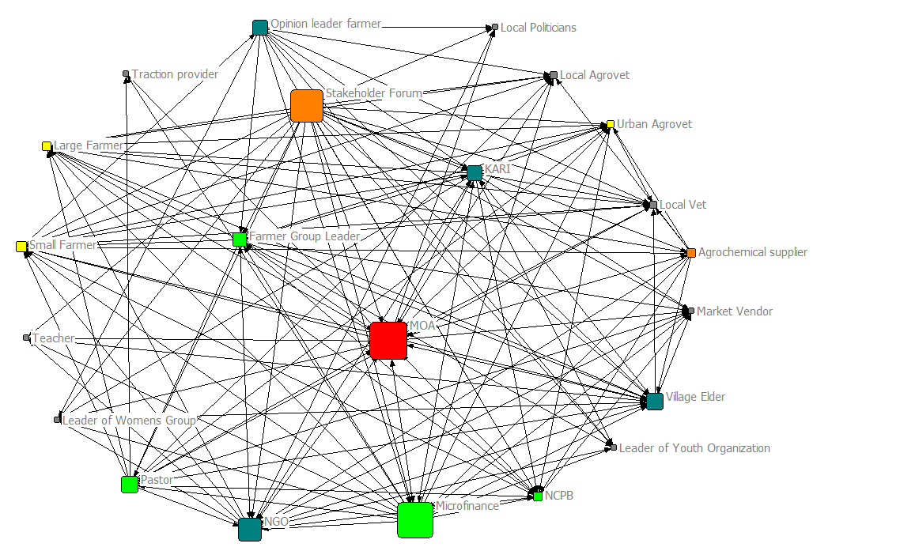
“Tillage causes land degradation”
Tillage causes land degradation
Strongly agree
Agree
Uncertain/neutral
Disagree
Strongly disagree
Not interviewed
Mapped Network of Agricultural Information flows and actor beliefs

Slide 36
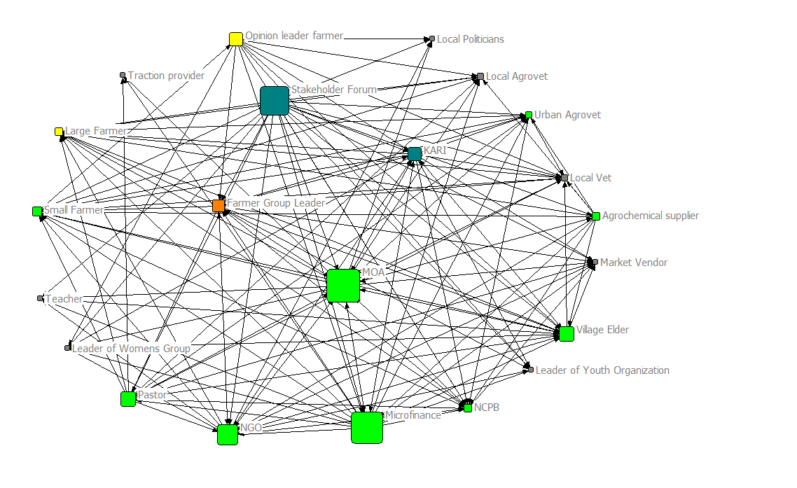
“One should maintain a permanent crop cover”
Strongly agree
Agree
Uncertain/neutral
Disagree
Strongly disagree
Not interviewed
Mapped network of information flows and beliefs

Slide 37
How can we use this information to promote CA within the agricultural production network?
Who does not understand CA?
What don’t they understand?
What do they need to know?
Who in the network could help them understand CA?
Who might be missing from the network?
What are the remaining challenges (agronomic, economic, practical, etc.) to be resolved for successful CA in Trans-Nzoia?
Who needs to be brought together to resolve these issues?

